Slide 1

Project Proposal Head and Neck Cancer
Tobias Hub, Nils Mechtel,
Pascal Poc, Niklas Urbanek
https://www.benzinga.com/analyst-ratings/analyst-color/12/11/3071761/seattle-genetics-falls-after-q3-results-and-analyst-down

Slide 2

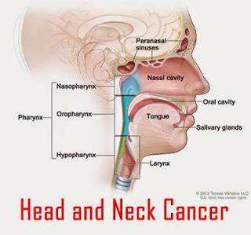
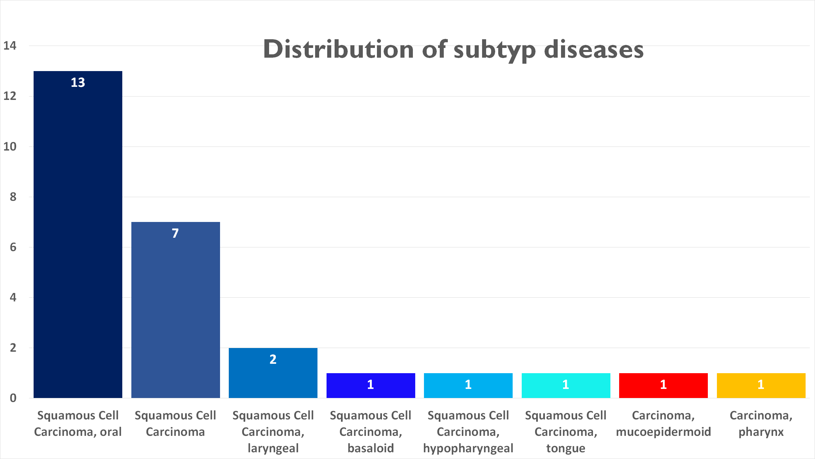
Characteristics about HNC
https://speciality.medicaldialogues.in/hepatitis-c-ups-risk-of-head-and-neck-cancers/

Slide 3
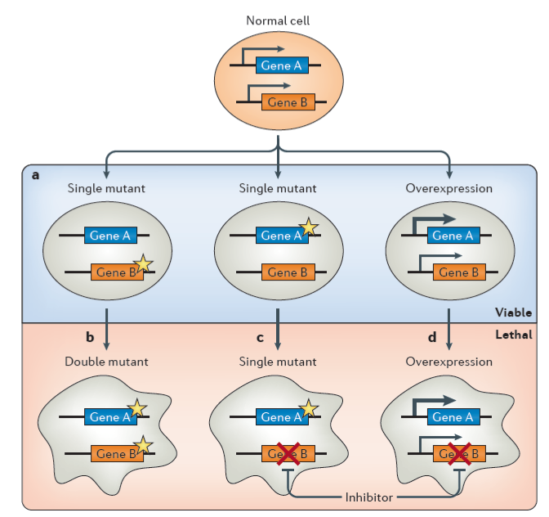
Synthetic lethality (SL) / Synthetic dosage lethality (SDL)
SL
SL
SDL
O’Neil, Nigel J., Melanie L. Bailey, and Philip Hieter. “Synthetic lethality and cancer.” Nature Reviews Genetics 18.10 (2017): 613.

Slide 4
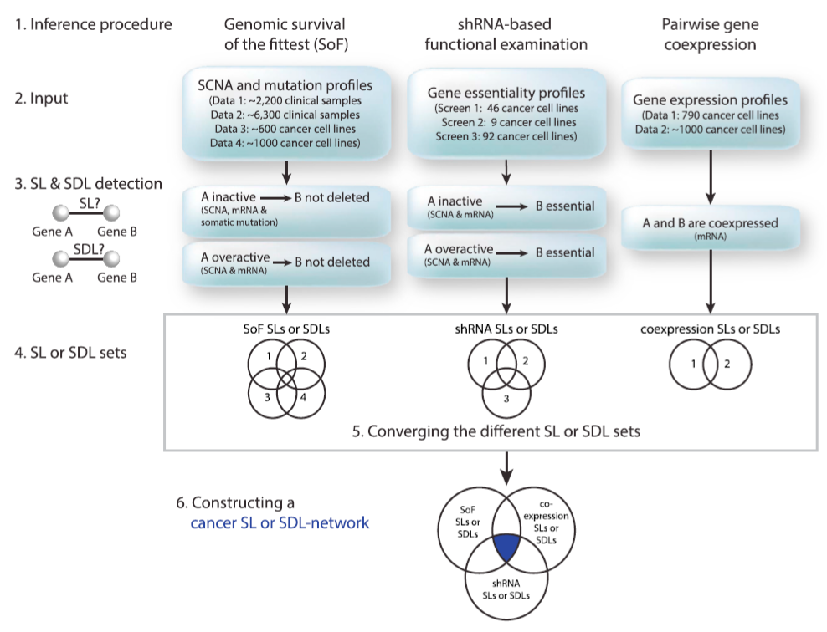
DAISY
Jerby-Arnon, Livnat, et al. “Predicting cancer-specific vulnerability via data-driven detection of synthetic lethality.” Cell 158.5 (2014): 1199-120.
Notes:
SoF: - Wilcoxon Sum Rank test von CNA Werten
- Wenn A inaktiv kann B nicht auch inaktiv sein, da Zelle sonst stirbt
Functional examination: - Knockdown für Gen B wird letal (wird höher) wenn Gen A inaktiv ist
- Wilcoxon Sum Rank test von knockdown Werten
Pairwise gene co-expression: - Spearmann Correlation von expression data

Slide 5






DepMapData
Gene expression
Copy number alteration
Mutation
CERES knockdown
Kockdown probability
Annotation
Notes:
ID, Primary Disease, Secondary Desease

Slide 6
Milestones
Data Cleanup & Descriptive Statistics
Identify genes of interest
Find SL/SDL partner
Mutation Prediction
Calendar week 22
Calendar week 24
Calendar week 26
Calendar week 28
Gene expression
Copy number alteration
Mutation
CERES knockdown
Annotation

Slide 7
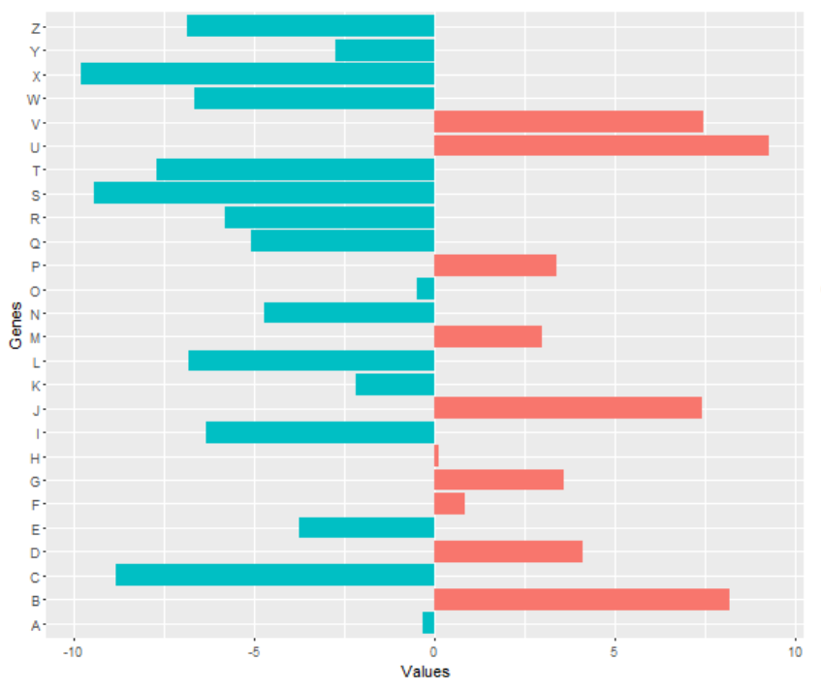
Data Cleanup & Descriptive Statistics
Identify genes of interest
Find SL/SDL partner
Mutation Prediction
Filtering information concerning wanted objects (ID, Disease, NA)
Investigate frequencies, expression data and essentiality
Plotting interesting data
Compact data overwiev
https://stackoverflow.com/questions/37753485/rotating-ggplot2-double-sided-barplot

Slide 8
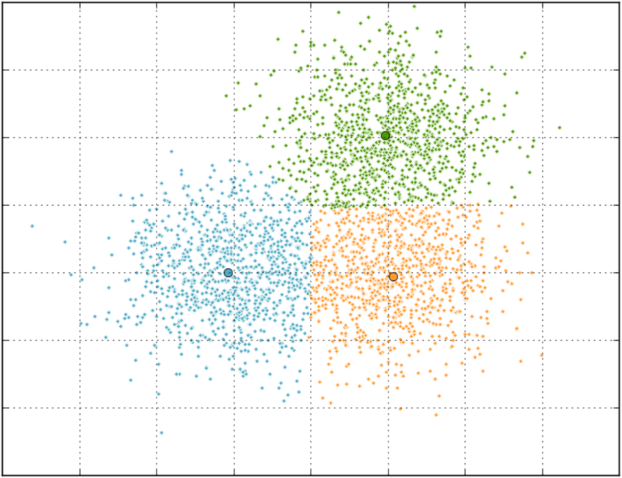
Data Cleanup & Descriptive Statistics
Identify genes of interest
Find SL/SDL partner
Mutation Prediction
Can we describe highly correlating groups bewteen CNA and expression values using a k-means cluster to identify our genes of interest?
Dimensional reduction: plotting CNA and overexpression
k-means
Investigate high frequencies of deleterious mutations
Comparing GOI with literature
CNA
Expression
https://dsp.stackexchange.com/questions/23662/k-means-for-2d-point-clustering-in-python

Slide 9
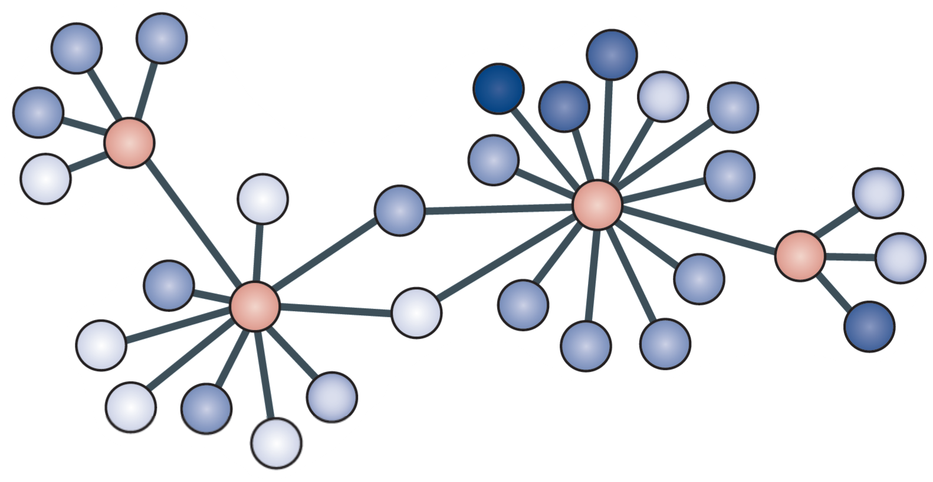
Data Cleanup & Descriptive Statistics
Identify genes of interest
Find SL/SDL partner
Mutation Prediction
Can we identify SL- and SDL-partners by testing SoF, functional examination and gene co-expression using statistical tests?
Survival of the fittest
H₀: no significant CNA level difference of gene B while gen A is inactive/overactive
Functional examination
H₀: no significant difference in knockdown levels of gene B while gene A is inactive/overactive
Gene co-expression
correlation between expression data of gene A and B
O’Neil, Nigel J., Melanie L. Bailey, and Philip Hieter. “Synthetic lethality and cancer.” Nature Reviews Genetics 18.10 (2017): 613.
Notes:
SL/SDL partner gefunden → knockdown probability, um auf die Signifikanz zu schließen
SoF: - Wilcoxon Rank Sum test von CNA Werten
- Wenn A inaktiv kann B nicht auch inaktiv sein, da Zelle sonst stirbt
Functional examination: - Knockdown für Gen B wird letal (wird höher) wenn Gen A inaktiv ist
- Wilcoxon Rank Sum test von knockdown Werten
Pairwise gene co-expression: - Spearmann Correlation von expression data

Slide 10
Data Cleanup & Descriptive Statistics
Identify genes of interest
Find SL/SDL partner
Mutation Prediction
Can we predict mutations in head and neck cancer via a logical regression model using expression-, CNA- and CERES kockdown-data?
Logical Regression
1. Examine correlation between variables
2. Estimating regression model
3. Evaluating validity and usefulness
Compare different models
Notes:
Pairwise scatter plot für correlation der variable
R – squared
F Test
T test

Slide 11
Tobias Hub, Nils Mechtel,
Pascal Poc, Niklas Urbanek
https://www.benzinga.com/analyst-ratings/analyst-color/12/11/3071761/seattle-genetics-falls-after-q3-results-and-analyst-down

